Slide 1
Design of Engineering Experiments
Chapter 7
7.1-7.3 only

Slide 2
Experiment
Need volunteers who
are male or female
who have or have not had a(n) energy/caffeine drink in the last hour
Take your resting pulse (beats per minute)
Turn in paper with above info as follows:
Gender: M or F
Energy/Caffeine Drink: Y or N
Resting Pulse: bpm value
H₀ : Gender does not affect resting pulse
H₁ : Gender affects resting pulse
H₀ : Drinking an energy/caffeine drink does not affect resting pulse
H₁ : Drinking an energy/caffeine drink affects resting pulse
H₀ : Gender and drinking an energy/caffeine drink interactively do not affect resting pulse
H₁ : Gender and drinking an energy/caffeine drink interactively affect resting pulse

Slide 3
The 2^{k} Factorial Design
A 2^{k} factorial design is one that has two factors (usually denoted A and B), each run at k levels.
The simplest 2^{k} design is a 2² design.
Factor A is run at two levels: “low” and “high”
Factor B is run at two levels: “low” and “high”
Low and High are relative…could be “Operator 1 and Operator 2”, or “Condition 1 and Condition 2”
Each combination of factor levels is called a treatment

Slide 4
A: the (estimated) main effect of Factor A.
It is a numerical value showing the average change as we move from the low level of Factor A to the high level of Factor A.
B: the (estimated) main effect of Factor B.
It is a numerical value showing the average change as we move from the low level of Factor B to the high level of Factor B.
AB: the (estimated) interactive effect of Factors A and B together.
It is a numerical value showing the average change as we move from the low level of Factor A/high level of Factor B to the high level of Factor A/low level of Factor B.
+ and - denote the factor setting for a run.
+ = high
- = low

Slide 5
Computing Effects
Table 1. Factorial Experiment Without Interaction
Factor | B_{low} | B_{high}
A_{low} | 10 | 20
A_{high} | 30 | 40
Note: there is only a sample of one per treatment here

Slide 6
Table 2. Factorial Experiment With Interaction
Factor | B_{low} | B_{high}
A_{low} | 10 | 20
A_{high} | 30 | 0

Slide 7
Part I. We will do three hypothesis tests using ANOVA:
Part II. We will develop a regression model to predict response:

Slide 8
Excel Tutorial: 2² Factorial Design Analysis
Part I: Hypothesis Tests using ANOVA

Slide 9
Example
Factor B
Low High
Low
Factor A
High
Factor A: Material Type Factor B: Temperature
Y: battery life (hours)

Slide 10
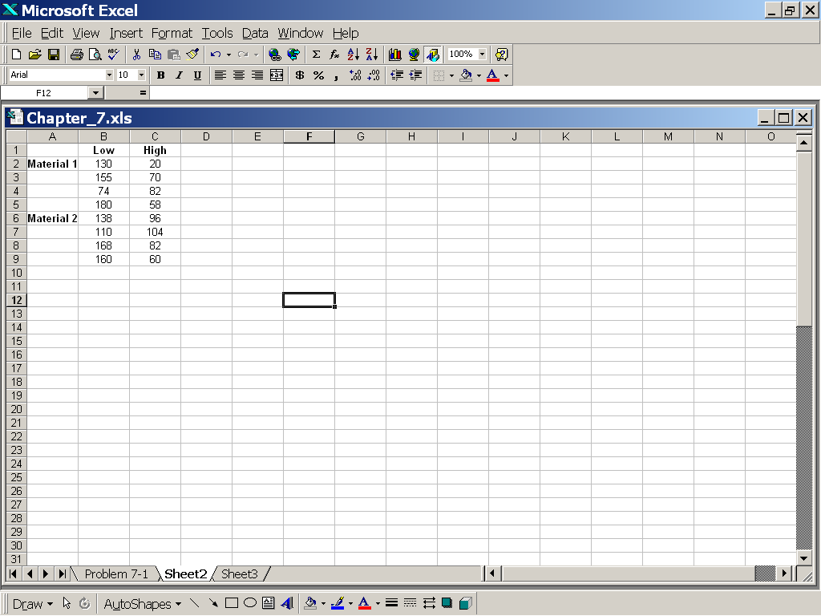
1. Input data such that Factor A is the rows and Factor B is the columns

Slide 11
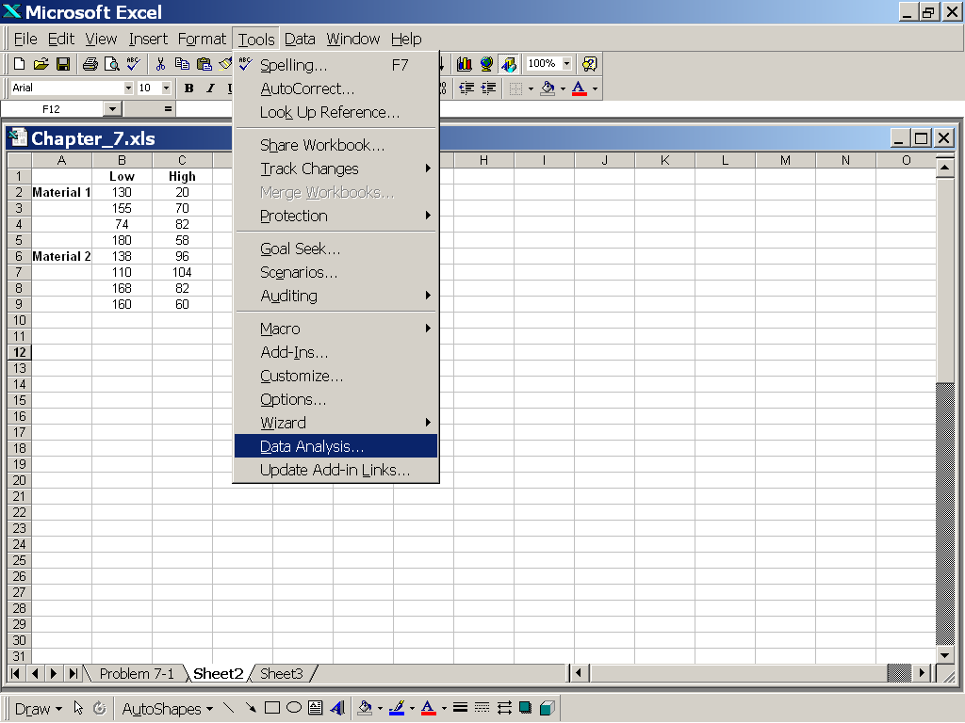
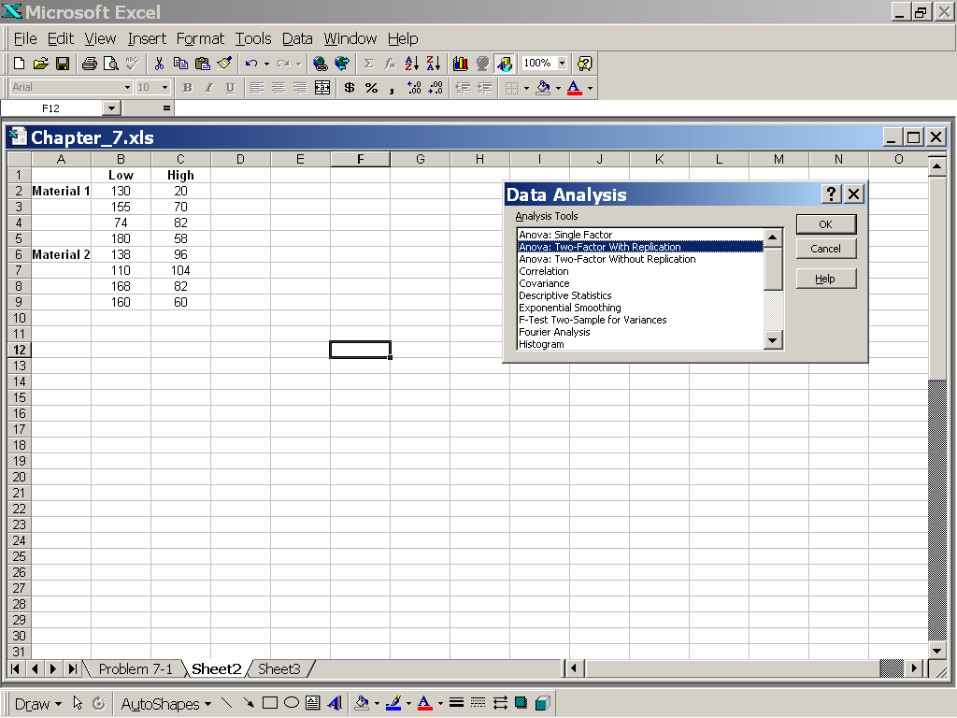
2. Go to Data then Data Analysis then ANOVA Two Factor with Replication

Slide 12
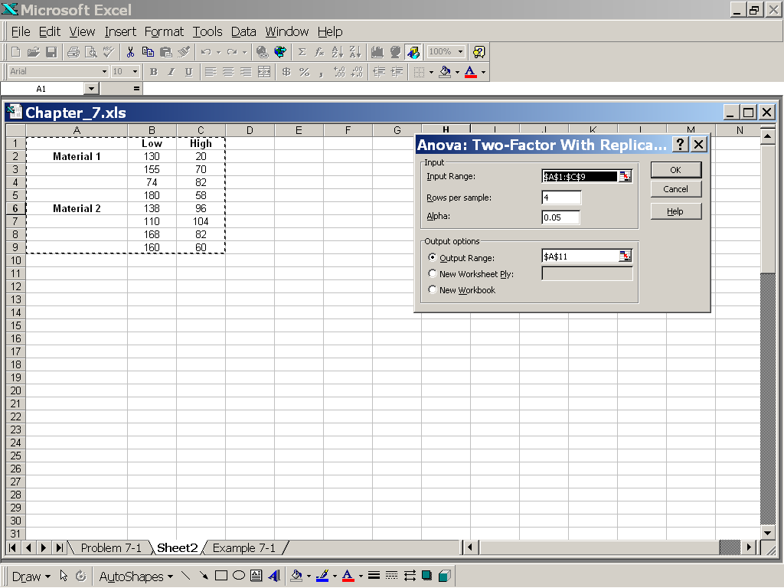
3. Fill in dialogue window. Include labels. Click OK.

Slide 13
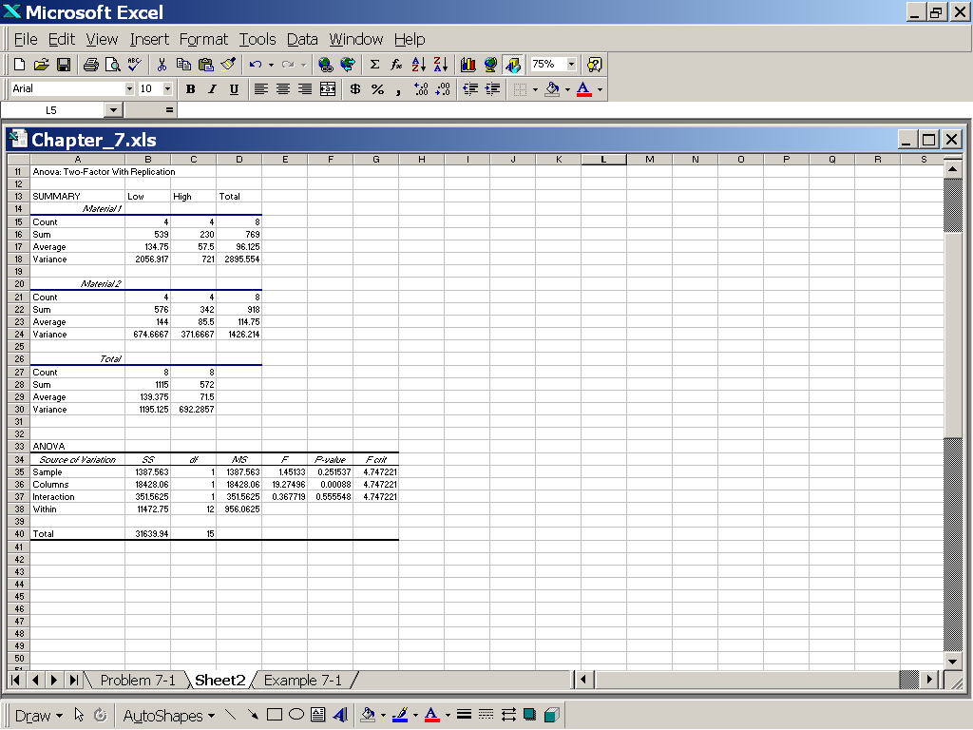
4. Interpret output
Sample corresponds to Material. P-value is .252. Fail to reject H0.
Columns corresponds to Temperature. P-value is .001. Reject H0.
Interaction corresponds to interaction of Material and Temperature. P-value is .556.
Fail to reject H0.
Sample: Factor A (Material)
Column: Factor B (Temperature)

Slide 14
Tutorial: How to compute numeric values of relevant constants
Part II: Regression Model

Slide 15
Regression Model
Y is the modeled response
x₁ is the value of Factor A (+1 or -1)
x₂ is the value of Factor B (+1 or -1)
x₁x₂ is the interactive value of Factors A and B (+1 or -1)
are numerical coefficients (constants)
n is the number of replicates

Slide 16
Algorithm
Factor B
Low High
Important note: For this problem, you would NOT have to compute A or AB, because the we failed to reject H₀ for those effects. The computations are shown here, however, in the event that you DO need to compute them for another data set.
Low
Factor A
High
1. From Part I, determine which of the β_{i} are significant (you will always compute β₀ , however).
2. Compute the estimate of β_{0,} ybar, the Main Effect of Factor A (A), the Main Effect of Factor B (B) and the Interactive Effect (AB) as needed
Recall that A is the difference between the average response when A is high and the average response when A is low
Recall that B is the difference between the average response when B is high and the average response when B is low
Recall that AB is the difference between the diagonal average responses
Problem 7-1 data

Slide 17
3. Develop the (final) linear model for the response
For Problem 7-1, we need only compute β₀ and β₂ because they are the only significant contributors to the response, battery life

Slide 18
Questions You Should Know Answers To For The Final Exam
An engineer suspects that the surface finish of metal parts is influenced by the type of paint used and the drying time. She selects two drying times: 20 minutes and 30 minutes. She selects two types of paint. Three parts are tested with each combination of paint type and drying time. The data and ANOVA Excel output are shown below:
ANOVA
Source of Variation | SS | df | MS | F | P-value | F crit
Sample | 0.083333333 | 1 | 0.083333 | 0.000444 | 0.983704 | 5.317655
Columns | 24.08333333 | 1 | 24.08333 | 0.12833 | 0.729438 | 5.317655
Interaction | 1140.75 | 1 | 1140.75 | 6.078597 | 0.038984 | 5.317655
Within | 1501.333333 | 8 | 187.6667
Total | 2666.25 | 11
 | Drying Time (min)
Paint | 20 | 30
1 | 74 | 78
 | 64 | 85
 | 50 | 92
2 | 92 | 66
 | 86 | 45
 | 68 | 85
What are the null hypotheses being tested?
Is the Paint factor significant? If so, what is the Main Effect of Paint?
Is the Drying Time factor significant? If so, what is the Main Effect of Drying Time?
Is the Interaction of Paint and Drying Time significant? If so, what is the Main Effect of this interaction?
What is the regression model that results from the Excel output and your computations of the constants in the model?
If we use Paint 2 and a 20-minute drying time, what is the predicted value for the surface finish using the model?
Use α = .05
Significant means you should include that term in the final model.

